Slide 1
PSCS_15:Design of CYBER-SECURITY ENABLED SMART CONTROLLER for grid-connected Microgrid
CSE7101- Capstone Project
Review-2
Batch Number: CCS01
Under the Supervision of,
Dr. Ruhin Kouser R
Assistant Professor – Senior Scale
School of Computer Science and Engineering
Presidency University
Roll Number | Student Name
20221CCS0004 20221CCS0055 | Jason Paul Adithya Shashidhar
Name of the Program: B.Tech – Computer Engineering (Cyber Security)
Name of the HoD: Dr.Anandaraj S.P
Name of the Program Project Coordinator: Dr.Sharmasth Vali Y
Name of the School Project Coordinators: Dr. Sampath A K , Dr. Geetha A

Slide 2
Content
Abstract
Literature Survey
Objectives
Existing System & Drawbacks
Proposed Model & Feasibility Study
Architecture Diagram
Modules
Hardware & Software Details
Timeline of the Project
References

Slide 3
Abstract
A cyber-security-enabled smart controller enhances the reliability and safety of grid-connected microgrids by integrating secure communication, real-time monitoring, and intelligent control algorithms. It ensures stable power exchange between distributed energy sources and the main grid while defending against cyber-attacks.

Slide 4
Literature Survey
Recent studies highlight:
AI-based anomaly detection in smart grids (IEEE 2022)
Secure communication protocols for distributed energy systems
Blockchain and IoT integration in microgrid management
Vulnerabilities in SCADA and smart inverters
Real-time intrusion detection using machine learning
Cloud-based microgrid monitoring and risks
Control system resilience under cyber-attack scenarios
Role of encryption and authentication in DER networks
Fault-tolerant control of hybrid energy systems
Comparative analysis of centralized vs decentralized controllers

Slide 5
Objectives
- Develop a secure and intelligent controller
- Ensure stable energy flow
- Implement cyber-protection mechanisms
- Enhance reliability and confidentiality
- Improve efficiency and resilience

Slide 6
Existing Systems and Drawbacks
- Lack integrated cyber-defense
- SCADA vulnerabilities
- Limited real-time anomaly response
- Poor scalability
- Weak encryption and authentication

Slide 7
Proposed Model and Feasibility Study
- Smart Controller with AI anomaly detection & blockchain-secured communication
- Hybrid encryption (AES + RSA)
- Simulation using MATLAB/Python
- Evaluation under attack scenarios
- Feasibility via IoT gateway prototypes

Slide 8
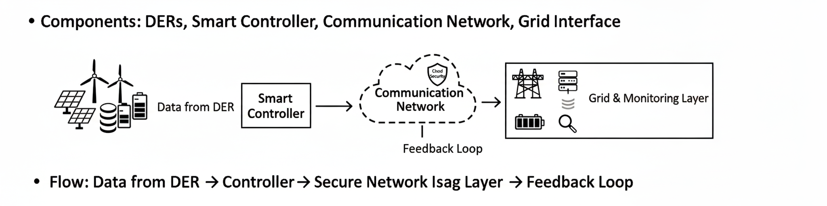
Architecture Diagram

Slide 9
Modules
1. Data Acquisition
2. Control Module
3. Cyber-Security Module
4. Communication Module
5. Monitoring & Analytics Module

Slide 10
Hardware and Software Requirements
Hardware:
- Raspberry Pi / ESP32
- Sensors: Voltage, Current, Temperature
- Communication: Wi-Fi / ZigBee / Ethernet
Software:
- MATLAB/Simulink, Python
- MQTT/HTTPS protocol
- MySQL/Firebase storage

Slide 11
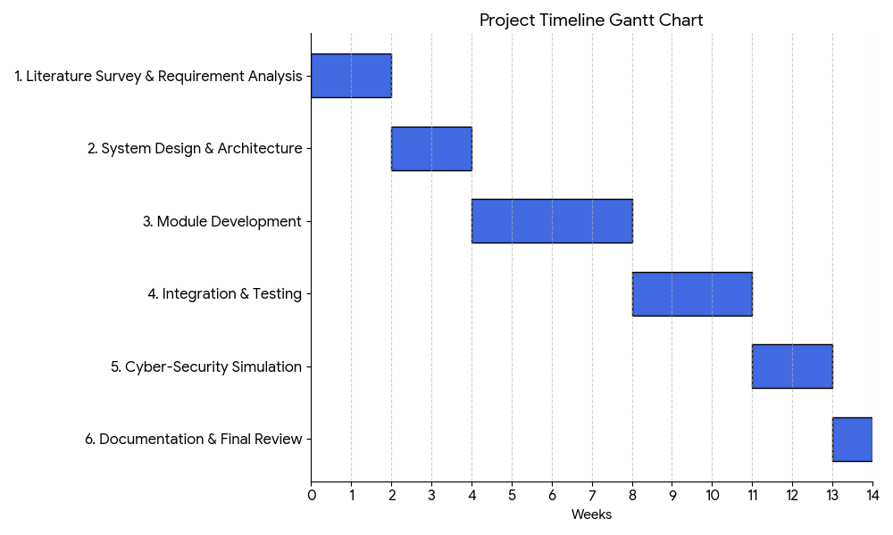
Project Timeline

Slide 12
References
1. IEEE Transactions on Smart Grid, 2022
2. IEEE Access – Cyber Security for Microgrids, 2023
3. Springer – Blockchain in Power Systems, 2022
4. NIST Guidelines on Smart Grid Cybersecurity, 2020
5. MDPI Energies – Secure Control Frameworks, 2023

Slide 13


